Slide 1
Analyzing PC Games: Trends and Insights
A Data Driven Exploration
By Terry Cleek and Avary Edwards

Slide 2
Abstract
The video game industry is a huge market that is constantly growing and innovating, and knowing what genres and types of games are popular right now can be pivotal for a video game developer to make a game that’ll sell well, or find an untapped market that isn’t overly saturated.
The cost of games can be a barrier to entry as well, and knowing what price point of game is best for that genre or market is important to make sure that it is profitable while not being so expensive that people avoid it.
We wanted to look at steam video game data to try and get some insights on prevalent genres and trends in the video game industry

Slide 3






Gathered Data and Stored in Database
SQLite3
Downloaded CSV files
Web Scrapping
SteamDB
SteamAPI & IGDB API

Slide 4
Data
For this project we sourced a dataset from kaggle that has a large list of steam games and their descriptions, and then we used webscraping to get another dataset that has counts for the top 200 games and their peak users for the day, users at that point in time, and the all time peak for that game.
We tried to get data from an API that has a lot of game data, but it was difficult to work with and had unclear documentation, so we pivoted and ended up webscraping information instead

Slide 5

Used Python Flask to access the SQLite3 Database

Slide 6
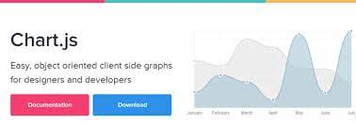
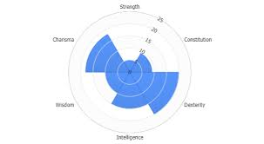
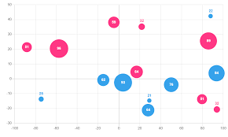
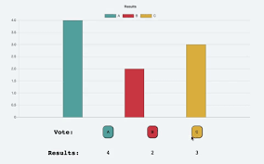
Use Chart.Js for Data Visualization

Slide 7
Issues
We found issues with getting data, as well as with getting the flask api to work with our dashboard. Initially we wanted to look at historical console data, but that data isn’t either available publicly, the data that is available isn’t complete, or it was behind a hefty paywall
When merging the webscraped data with the dataset that had the info on all the steam games, most of the webscraped games were not present in the dataset since they are newer games, and the steam games dataset was a couple years old. Also there were some differences in how the names were recorded, but since the steam games dataset was 40,000+ different games, it was nearly impossible to fix everything individually, and some games info had to be entered manually

Slide 8
What we would do with more time
Given more time we would work on fixing issues present in the dashboard, and then also add some more interactive portions to look at other metrics
It would be nice too to look at metrics for developers/publishers, but the dataset we have would be incredibly difficult to clean the developer portion, so we could either get the IGDB api to work, or potentially find a different dataset

